Slide 1
Module 3 Week 1- DynamoDB

Slide 2
DynamoDB Roadmap
Week 1
Introduction to NoSQL Databases
Key-value
Document
Column
Graph
Introduction to Big Storage Systems
Introduction to Key-value databases
Key-value internals
Pros
Cons
Getting Started with DynamoDB
Setting up DynamoDB locally
The basics
Lab

Slide 3
Introduction to NoSQL Databases
and Big Data Storage Systems

Slide 4
Introduction
NoSQL
Not only SQL
Most NoSQL systems are distributed databases or distributed storage systems
Focus on semi-structured data storage, high performance, availability, data replication, and scalability
Typical applications that use NoSQL
Social media, web links, user profiles, posts and tweets, road maps and email
Example: Facebook – 2.23 billion active FB users in 2018, 11% increase over past year. 4.7 billion pieces of content shared daily (zephoria.com)

Slide 5
Introduction
Distributed computing system
Consists of several processing sites or nodes interconnected by a computer network
Nodes cooperate in performing certain tasks
Partitions large task into smaller tasks for efficient solving
Big data technologies
Combine distributed and database technologies
Deal with mining vast amounts of data

Slide 6
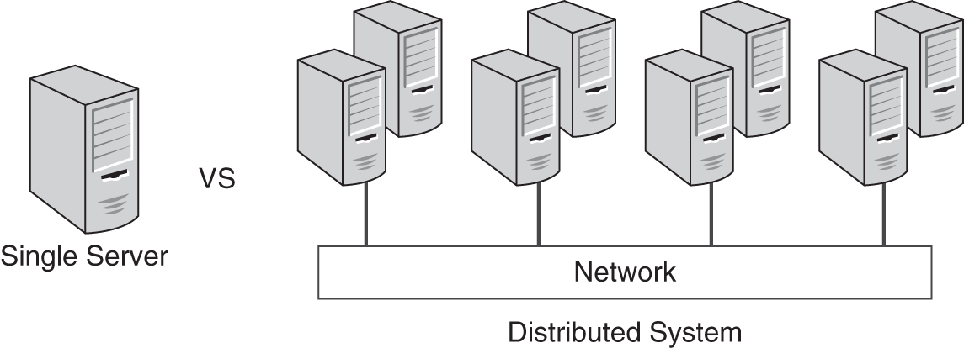
Introduction
Distributed system – systems run on multiple servers, instead of one computer:

Slide 7
Data Management & Distributed Databases
The following are key features of database
Store data persistently
Ensure data in the database is consistent with the latest data users put into the database
Ensure data is available when needed
Ensure data is durable and not lost due to common hardware failures
These features of databases are more difficult to implement in distributed databases than in non-distributed

Slide 8
Consistency vs Availability
Database consistency – reliability of its functions’ performance
Reads return the value of the last write
Reads return the same value regardless of where they are originated
Database availability – system’s ability to complete a certain operation
System might be unavailable for writes while being available for reads
System might be unavailable for admin operations while being available for data operations

Slide 9
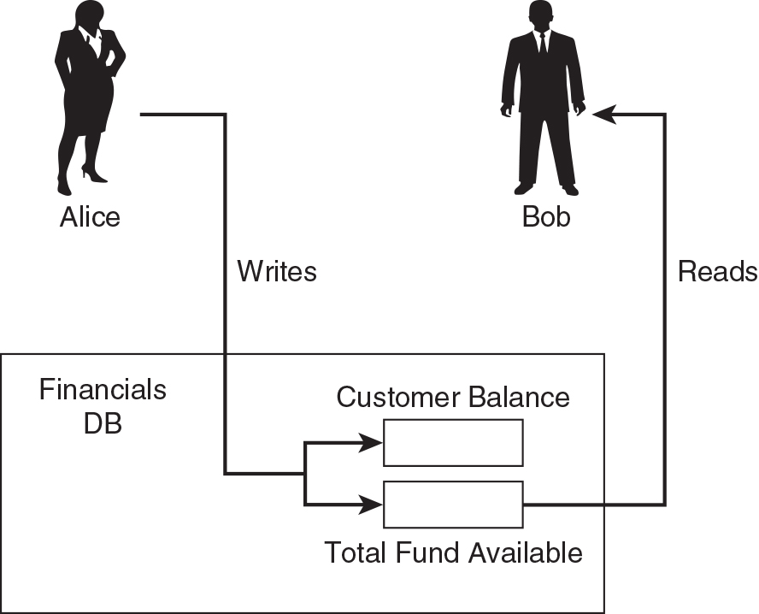
Consistent State

Slide 10
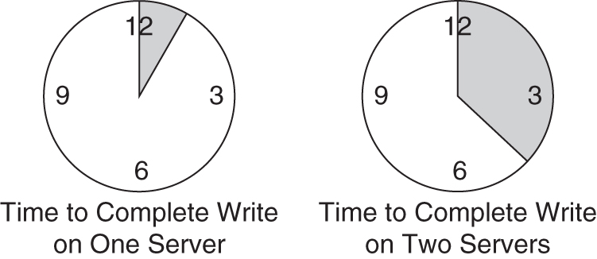
Consistency of Database Transactions
Database transaction
Operation made of multiple steps
All steps must complete for the transaction to complete

Slide 11
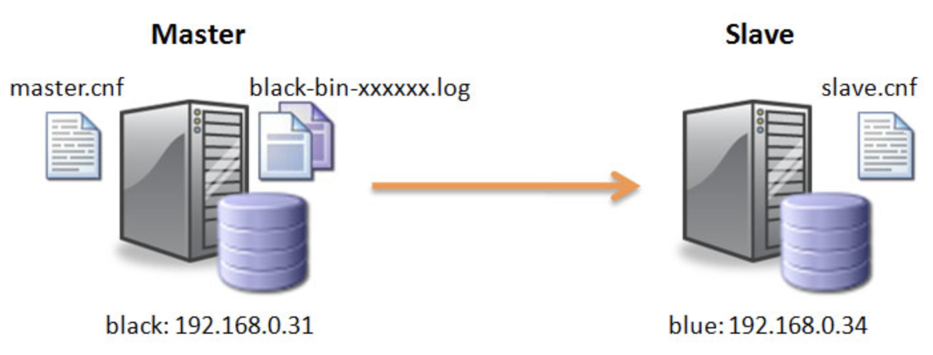
MySQL Replication

Slide 12
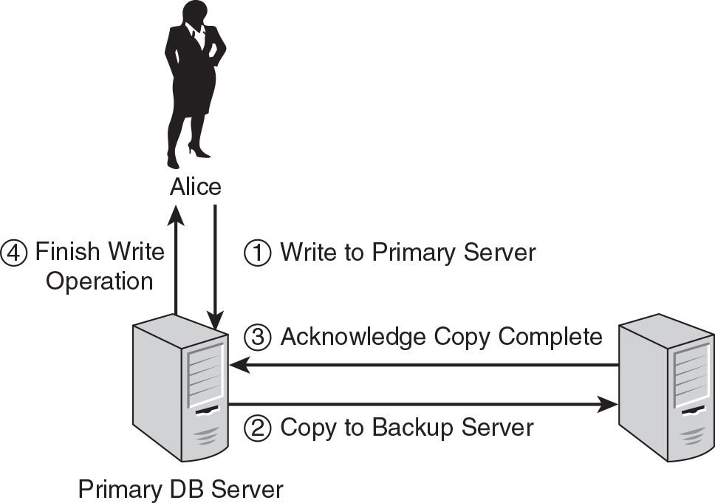
Data Availability and No Data Loss

Slide 13
Availability and Consistency in RDBMS
Atomic
All statements execute successfully or are canceled as a unit
Consistent
Database that is in a consistent state when a transaction beings, is left in a consistent state by a transaction
Isolated
One transaction does not affect another
Durable
All changes made by transaction that complete successfully are recorded properly in the database
Changes are not lost

Slide 14
Availability and Consistency in NoSQL Systems
Challenges in maintaining a DBMS with multiple servers
Two database servers must keep consistent copies of data = longer times to complete transactions
NoSQL databases often implement eventual consistency
Might be a period of time where copies of data have different values
Eventually all copies will have the same values

Slide 15
Availability and Consistency in NoSQL Systems
CAP Theorem – distributed databases cannot have consistency, availability and protection all at the same time
(C) - Consistency
(A) – Availability
(P) Protection
Designer can choose two of three to guarantee
Weaker consistency level is often acceptable in NOSQL distributed data store
Guaranteeing availability and partition tolerance more important
Eventual consistency often adopted

Slide 16
Availability and Consistency in NoSQL Systems
To have availability and partition tolerance – give up consistency
Communication between two nodes breaks, can’t sync updates:
If you allow the nodes to sync – give up consistency
Or consider the cluster to be down – give up availability

Slide 17
Availability and Consistency in NoSQL Systems
Consistent and Available
Keep data consistent within all nodes while online
With partition data will be out of sync
Available and Partitioned
Nodes remain online even if they cannot communicate with each other
Data will be synced once partition is resolved
No guarantee that data will be the same on all nodes
Consistent and Partitioned
Data consistent between all nodes
When nodes go down, data not available

Slide 18
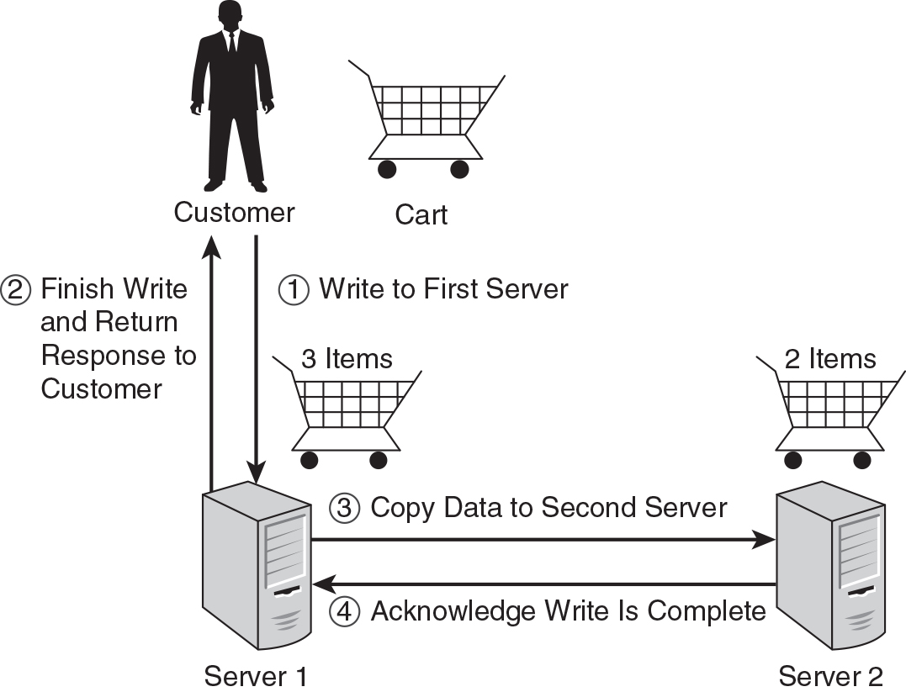
Availability and Consistency in NoSQL Systems

Slide 19
Availability and Consistency in NoSQL Systems
NoSQL databases support BASE:
(BA) – Basically available
Can be failure in some parts of distributed system and the rest of the system will continue to function
(S) – Soft state
Data maybe eventually overwritten by more recent data
(E) - Eventually consistent
Sometimes a database might be in inconsistent state

Slide 20
Data Management & Distributed Data Systems (trade-offs)
Each database model (flat files, RDBMS) has limitations
Flat files:
Inefficient to access data in any way other than by the way it is organized in a file
Changes to file structures require changes to programs
Data can be stored in multiple files – difficult to have consistent sets of data
RDBMS:
Difficult to scale horizontally

Slide 21
Data Management & Distributed Data Systems (trade-offs)
NoSQL databases address four key limitations of relational databases
Scalability
Cost
Flexibility
Availability

Slide 22
Additional Characteristics of NoSQL Systems
NOSQL characteristics related to data models and query languages
Schema not required
Less powerful query languages
Versioning

Slide 23
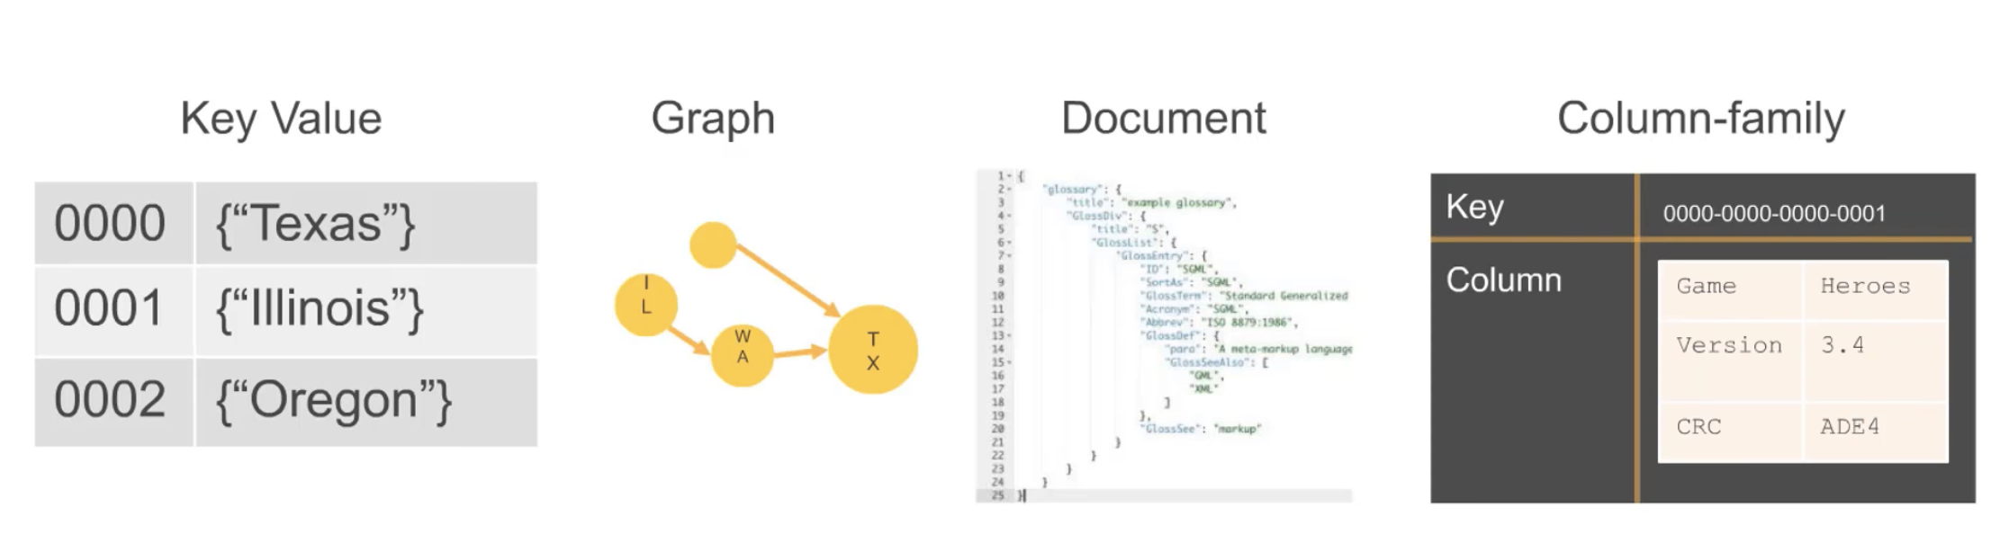
Four Major Types of NoSQL databases
There are four types of NoSQL databases:
Key value
Work with simple model based on keys, which are identifiers for looking up data and values, the data that is associated with keys
Document
Also use identifiers to look up values, but the values are more complex. Documents are collections of data items stored together in a flexible structure

Slide 24
Four Major Types of NoSQL databases (con’t)
Column family
Have some of the characteristics of relational databases (collections of columns)
Trade some of the functionality of relational databases
Graph
Suited to model objects and relationships between objects

Slide 25
Key-Value Pair Databases
Modeled on two components
Keys
Identifiers associated with values
Keys must be unique
Values
Data stored along with the keys
Can store simple and complex values
Can only have four basic operations
Insert key pair (key + value) into collections
Delete key pair
Update key pair
Search for value associated with particular key

Slide 26
Differences Between Key-value and Relational Databases
Modeled on minimal principles for storing and retrieving data
No joins
No rich query language
No schema – all data integrity goes into application
Some key-value databases support collections

Slide 27
Document Databases
Document stores
Collections of similar documents
Don’t have to define fixed schema
Individual documents resemble complex objects or XML documents
Documents are self-describing
Can have different data elements
Can create, update, insert, delete
Documents can be specified in various formats
XML (Extensible Markup Language)
JSON (JavaScript Object Notation)

Slide 28
Differences Between Document and Relational Databases
Key difference – no predefined schema
Documents can have embedded documents and lists of multiple values within a database
No need to join documents

Slide 29
Column family Databases
Column family – most complex
Column is a basic unit of storage (name + value)
Row – set of columns
Columns are grouped into collections
Column family can support millions of columns
No requirement for predefined schema

Slide 30
Differences Between Column family and Relational Databases
Have some of the characteristics of relational databases (collections of columns), but you cannot join
Tables in RDBS = fixed structure
Column family = set of columns can vary from one row to another
RDBMS can store data about an object in multiple tables (use join to get all the data)
Column family databases – all relevant information is in a single row
Query languages similar to SQL

Slide 31
Graph Databases
Most specialized
Suited to model objects and relationships between objects
Instead of rows and columns, use nodes and relationships
Node:
Object that has an identifier and a set of attributes
Relationship:
Link between two nodes that contain attributes about that relation.
Nodes can be very complex

Slide 32
Differences Between Graph and Relational Databases
Graph databases are designed to model adjacency between objects
RDBMS is about relationships and Graph databases are about data
RDBMS – hard to represent complex analysis
Graph databases – can query more efficiently when paths through graphs are involved

Slide 33
NoSQL database Examples
BigTable
Google’s proprietary NoSQL system
Column-based or wide column store
DynamoDB (Amazon)
Key-value data store
Cassandra (Facebook)
Uses concepts from both key-value store and column-based systems

Slide 34
NoSQL database Examples
MongoDB and CouchDB
Document stores
Neo4J and GraphBase
Graph-based NOSQL systems
OrientDB
Combines several concepts

Slide 35
Introduction to Key-Value Databases

Slide 36
Key-Value Databases
Data is stored with identifiers known as keys
We only define key, rest of attributes defined at the time of record insertion
Key-value store is a more complex variation of array data structure
Key-value databases are build on the concept of associative array
Associative array is a data structure like array, but is not restricted to using integers as indexes or limiting values to the same type
Key-value databases impose minimal set of constraints on how you arrange your data

Slide 37
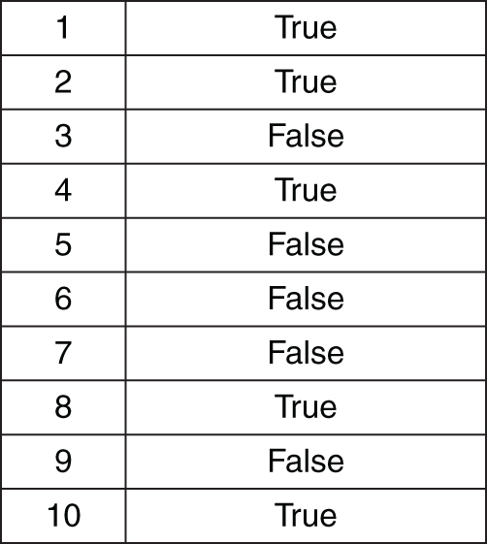
Key-Value Databases
exampleArray[0] = ‘Hello World’
exampleArray[1] = ‘Goodbye World’
exampleArray[2] = ‘Hey, World’

Slide 38
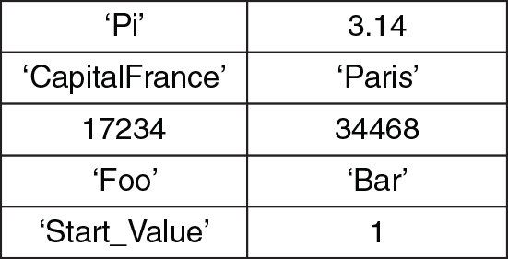
Key-Value Databases
exampleAssociateArray[‘Pi’]=3.1415
exampleAssociateArray[‘CapitalFrance’]=‘Paris’
exampleAssociateArray[‘ToDoList’]={‘Alice’ : ‘run reports; meeting with Bob’, ‘Bob’ : ‘order inventory; meeting with Alice’ }
exampleAssociateArray[‘17234’]=34468

Slide 39
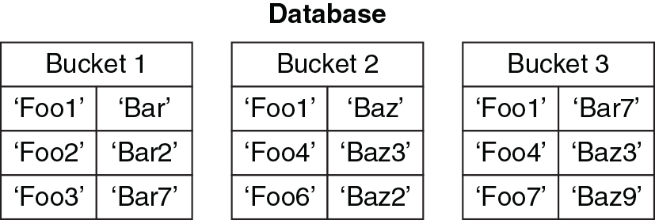
Key-Value
Each value MUST have a unique identifier (key)
Key must be unique within namespace defined by key-value database

Slide 40
Key-Value Terminology
Key
A reference to a value (like address).
Can take on different forms depending on the key-value database used.
Value
An object (typically a set of bytes), associated with a key.
Can be integers, floating-point numbers, strings of characters, BLOBs, JSON objects, images, audio.
Most key-value databases will have a limit on the size of a value.
Namespace
Collection of key-value pairs
Duplicates not allowed

Slide 41
Keys
All the access to the database is via keys
A client program can either:
Get value for the key (key)
Return value associated with that key
Put value for the key (key, value)
Associating value with key
Multi-get (key1, key2..keyN)
Return list of values associated with the list of keys
Delete a key from data store (key)
Remove entry for the key from the data store
Keys are flexible – numbers, integers, character strings, list of objects
Use hash function to map from integers, character strings or list of objects to a unique string or number

Slide 42
Hash Functions
Hash functions
Algorithms that map from an input (e.g. a string of characters to an output string)
e.g. – ‘Hello world’ maps to 2aae6c35c94fcb415dbe95f408b9ce91ee846ed
Designed to distribute inputs evenly over the set of all possible outputs
Ranges of output values can be assigned to partitions, where each partition will get the same amount of data
Partition
Designed to divide large databases into subsets that are easily managed on multiple servers.

Slide 43
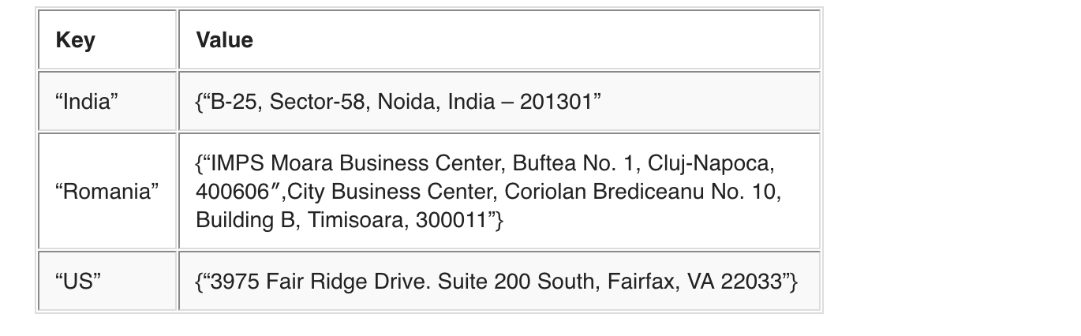
Key-value example
Keys can be auto-generated (same as in RDBMS) or synthetic

Slide 44
Values
Data item itself – can have different formats for different key-value storage systems
Both keys and values can be complex compound objects and sometimes lists, maps or other data structures
Every value must be associated with a unique key
Getting value out by supplying key is very fast

Slide 45
Key-Value Database Cons:
Cannot have complex query filters
No joints – have to be done in code
No group by, order by
No ACID transactions
No triggers
No foreign key constraints
Many data structures (objects) cannot be easily modeled as key value pairs
As volume of data increases, maintaining unique values as keys maybe hard

Slide 46
Where to use key-value (examples):
Log analysis
Social networking feeds
Time-based data
Large data feeds that need to be analyzed before RDBMS entry

Slide 47
Getting Started with DynamoDB

Slide 48
Key Aspects of DynamoDB
Was built to address scaling needs of Amazon’s e-commerce platform
Non-relational model
Use alternate methods for data management
Fully managed cloud service
Offload administrative tasks of operating and scaling
Fine-grained access control
Infinitely Scalable
Automatically scales capacity up or down
Auto scaling is enabled by default
“The Dynamo Paper”

Slide 49
DynamoDB
Managed NoSQL database service provided by Amazon
Have to pay for throughput only – i.e. read write operations per second
All infrastructure (storage, server, etc.) managed by Amazon
By default Eventually Consistent
Can choose Strongly Consistent Reads
Read operations (GetItem, Query and Scan) provide ConsistentRead parameter.

Slide 50
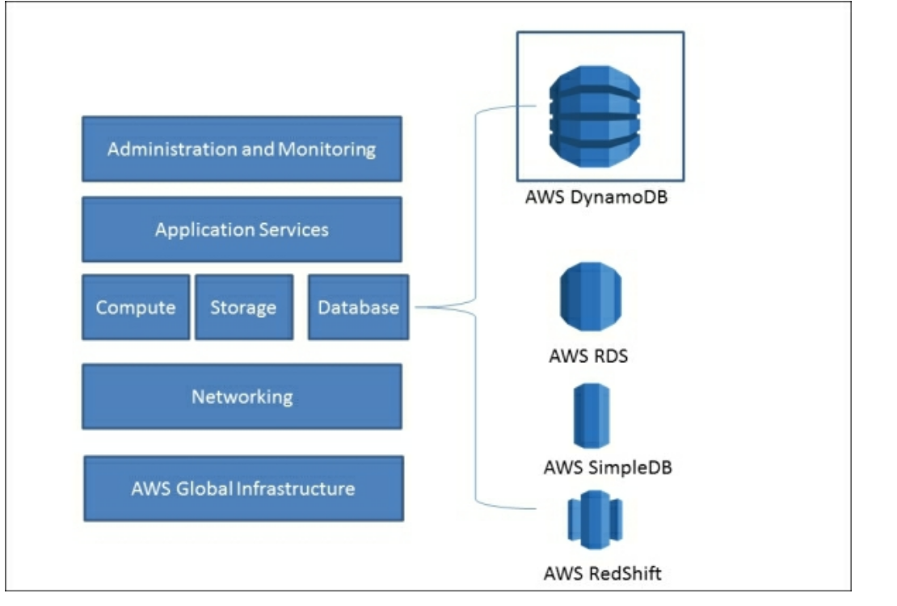
Key Aspects of DynamoDB

Slide 51
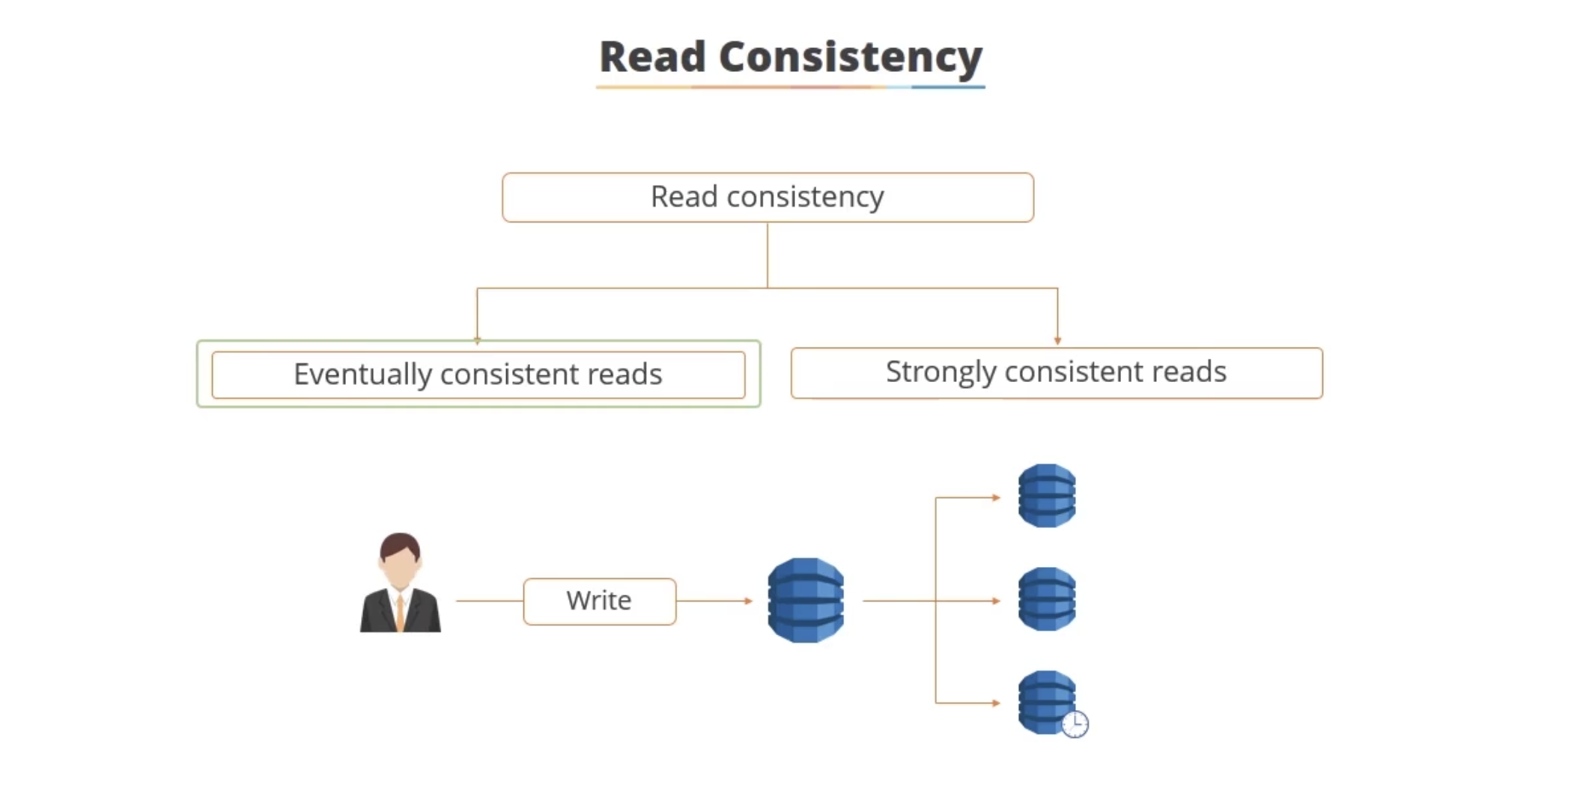
Key Aspects of DynamoDB

Slide 52
Access DynamoDB
Directly interact with AWS DynamoDB
AWS CLI: command line utility
Need Python 2 or Python 3 (pip)
Pip helps you install other Python tools
AWS API: Eclipse with AWS SDK
Run DynamoDB locally
Download local version
DynamoDB Management Console

Slide 53
Key Features of DynamoDB
Spreads data and request traffic to multiple servers to provide better throughput and storage
Data is stored in SSD (solid state drive) and is replicated over multiple availability zones
Provides data backup using S3 storage
S3 – Simple Storage Service
Can store/retrieve any amount of data
Allows to decide expire time of items (set a time-to live parameter)
Can integrate with IDM (Identity and Access Management)

Slide 54
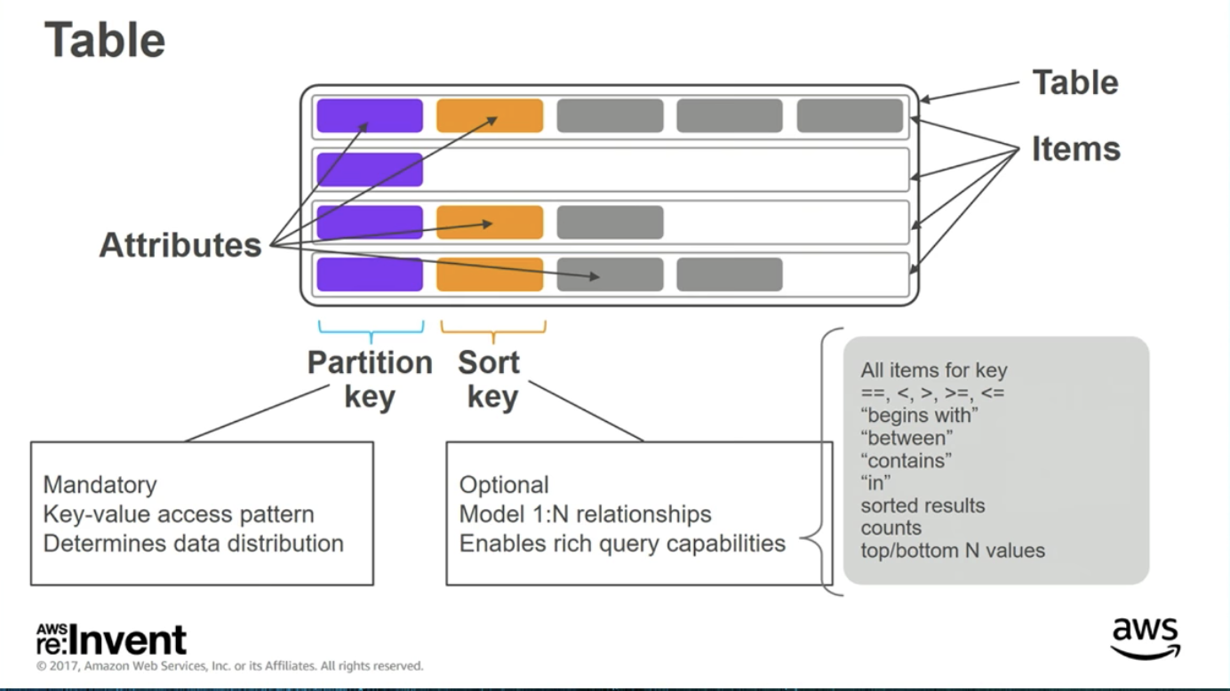
DynamoDB Data Model

Slide 55
Difference between SQL and DynamoDB
SQL | DynamoDB
Fundamental structure is table – schema must be defined in advance before operation on table begins | Uses primary key and a schema is NOT required to be defined in advance. It also uses different data sources
All table information is accessible and we can query almost all the data. Use SQL | Only primary key is available to query. To get more flexibility in querying data, one must use secondary indexes
Information is stored in rows in tables | Information is stored as items in a table and the item structure can vary as it is schemaless

Slide 56
Difference between SQL and DynamoDB
SQL | DynamoDB
Use SELECT statement and filtering (WHERE) statements to load the data | Use GetItem, Query and Scan APIs to load the data
Use standard indexes created using SQL (CREATE INDEX…) Changes that happen in table are managed by indexes | Use secondary indexes for faster data retrieval. Secondary indexes use partition keys and sort keys
To modify table use UPDATE with SET operator | Use UpdateItem to handle update operation on table data
To delete the data from a table – use DELETE | Use DeleteItem to handle delete operation

Slide 57
Difference between SQL and DynamoDB
SQL | DynamoDB
Delete table from the database – DROP TABLE command | Use DeleteTable operation to handle the deletion of a table
Foreign key concept is used extensively to query data from multiple tables. | No foreign key concept

Slide 58
Advantages of DynamoDB
Cost-effective
Pay for throughput and read/write operations
It is scalable
Scales up horizontally, can distribute single table among multiple servers
It is flexible
Supports large range of datatypes, table structure is schemaless, new changes easily adapted
Free tier
40 million operations per month

Slide 59
Disadvantages of DynamoDB
ACID properties
No support, have to manually perform transaction management to achieve consistency and integrity
Query operation – Primary Key only
To access data more efficiently, need scan and secondary indexes
Single row limit
Cannot store more than 64 KB of data in single row
No joins and no triggers
No support for foreign key
Streams instead of triggers

Slide 60
Setting up DynamoDB locally
AWS provides DynamoDB version for local installation
Fully functional, self-contained version of Amazon’s DynamoDB
Supports creation of applications without web services or connection
Reduces provisioned throughput, data storage and transfers
Need to have latest version of JDK installed for it to run
Database uses port 8000 by default (can run it on a different port via –port option)
DynamoDB local interface is a JavaScript shell
Can use Java API for DynanoDB to write your application to work with it

Slide 61
Setting up DynamoDB locally
Regions and distinct AWS accounts are not supported locally
Can’t do parallel scans locally
Both web and local services have a data retrieval limit of 1 MB

Slide 62
Downloadable DynamoDB vs DynamoDB Web Service
Downloadable version is for testing/development only
DynamoDB Web Service is managed
Regions/distinct AWS accounts are not supported locally
Provisioned settings ignored locally
Scan operations are done sequentially
Speed of read/write limited by your computer only
Both versions enforce 1 MB limit on data returned per result set.

Slide 63
DynamoDB LAB

Slide 64
Sources
https://www.dynamodbguide.com/the-dynamo-paper
“Seven NoSQL Databases in a Week”
AWS: reInvent

